Slide 1
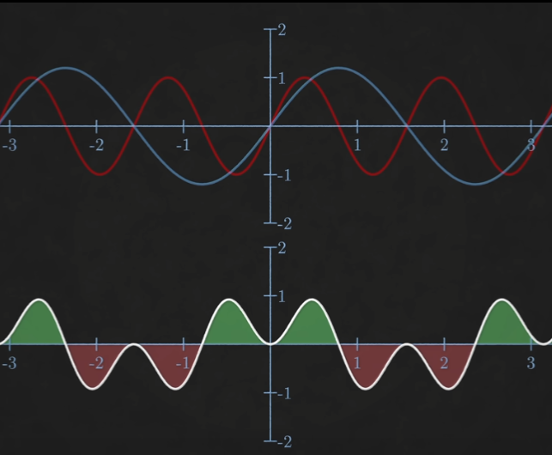
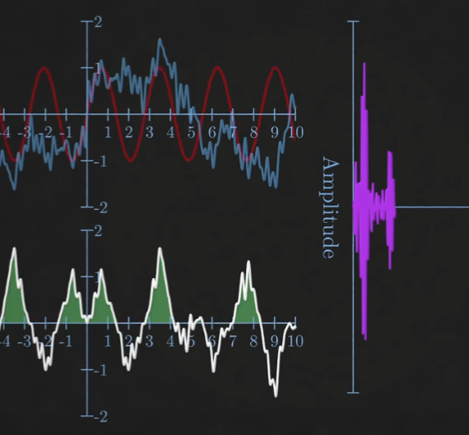
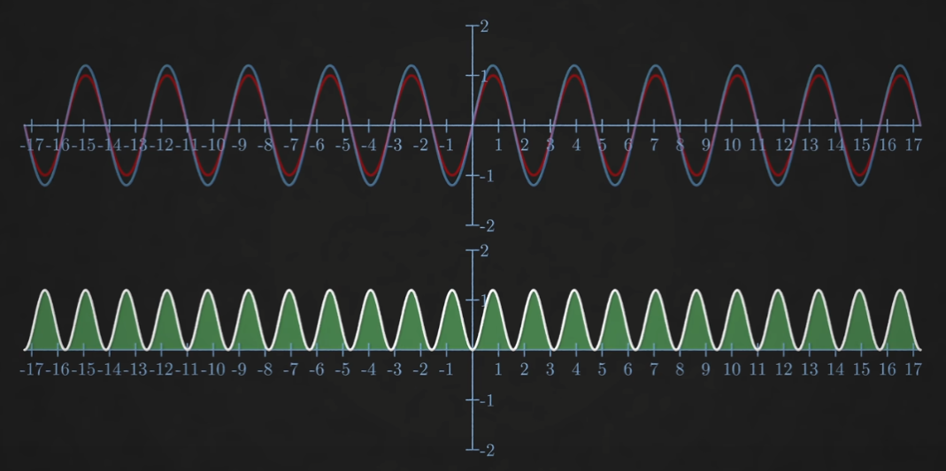
Halfway presentation: Fourier Analysis in Optical Coherence Tomography
Saban Caliskan
Research Internship

Slide 2

Fourier Transform
Linear Transformation
$\hat{f}\left(ξ\right)=\int_{−∞}^{∞}{f\left(x\right)ⅇ^{−ⅈ2πξx}ⅆx}$
$f_{inv}\left(x\right)=\int_{−∞}^{∞}{\hat{f}\left(ξ\right)}ⅇ^{ⅈ2πξx}dξ$
$e^{iθ}=\cos\left(θ\right)+i ∙\sin\left(θ\right)$
Periodicity and Shape
Source: https://en.wikipedia.org/wiki/Fourier_Transform
Source: https://en.wikipedia.org/wiki/Fourier_Series

Slide 3
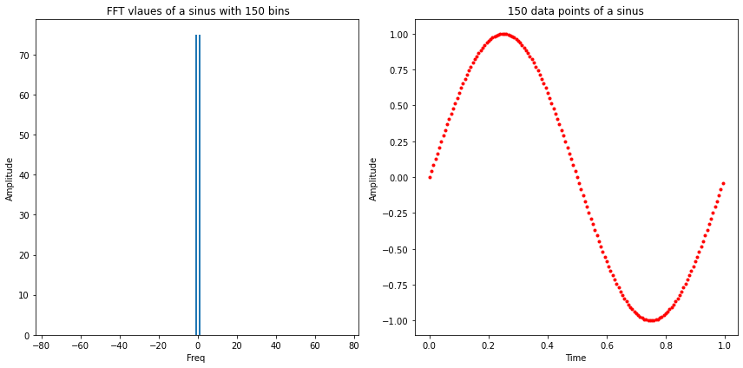
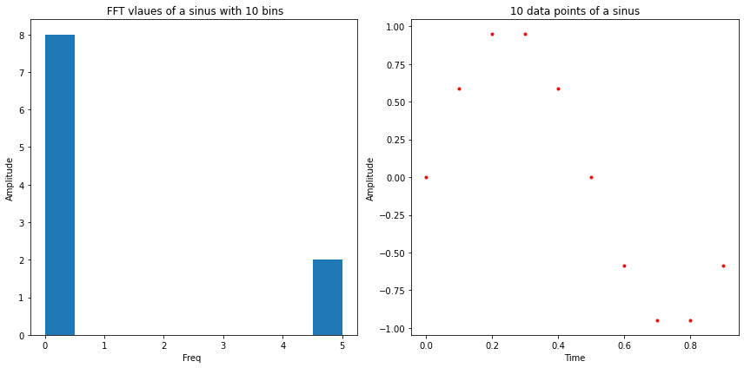
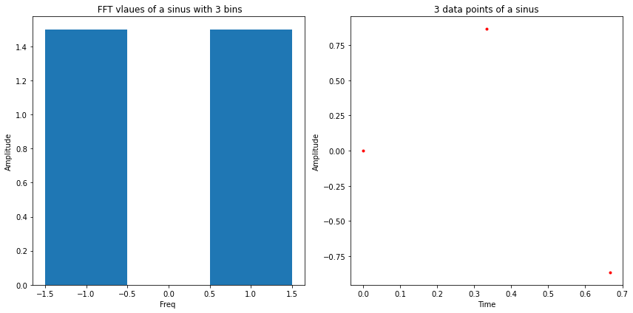
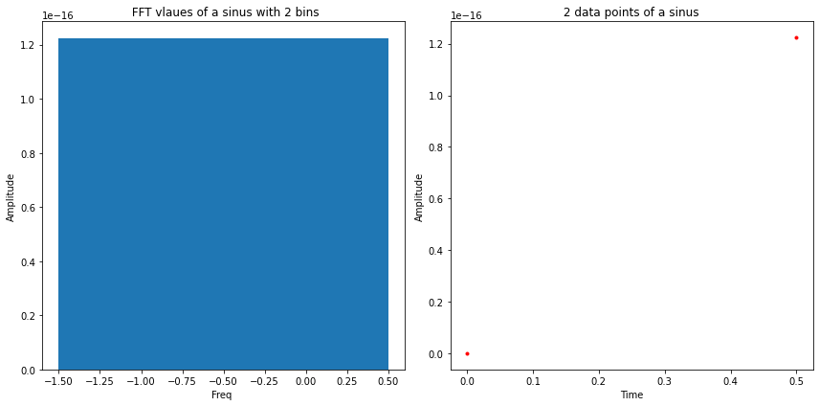

Discrete Fourier Transform
Discrete data
$X_{k}=\sum_{n=0}^{N−1}{x_{n}∙e^{−i\frac{2π}{N}kn}}$
All possible frequencies: $f_{n}=n\frac{1}{2T} , n∈[1,N]$
Nyguist Frequency
‘the Nyquist frequency is the frequency whose cycle-length is twice the interval between samples’
i.e: at least 2 samples, thus: $f_{max}=\frac{N}{2T}$
Computation $∝N^2$

Slide 4
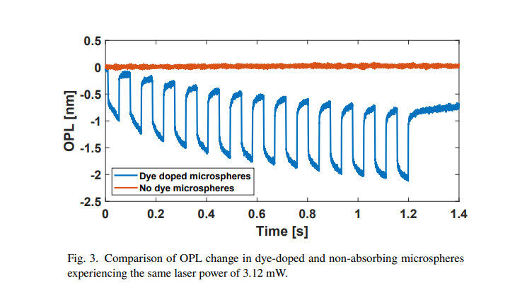
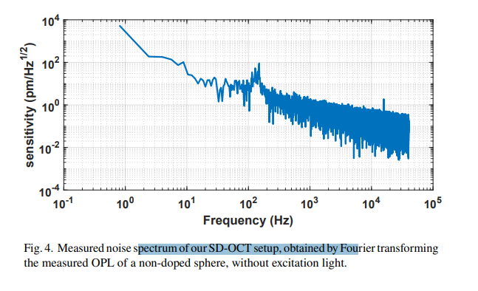
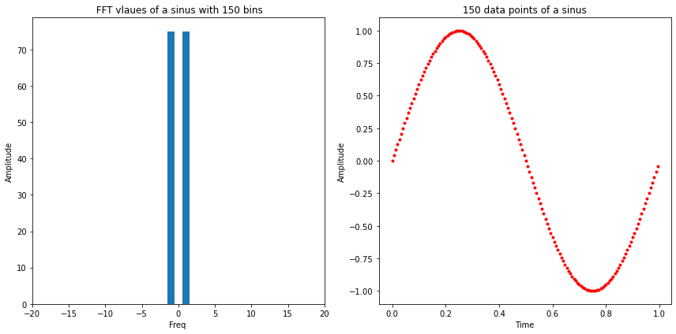
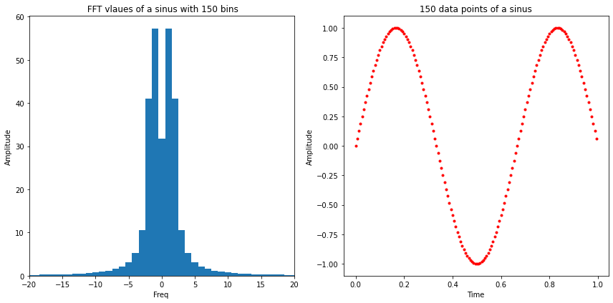
What is our goal?
Reflected spectrum of OCT
frequencies
Finding the exact location of the peak in FFT
What if the exact frequency is not exactly in the centre of a bin?

Slide 5
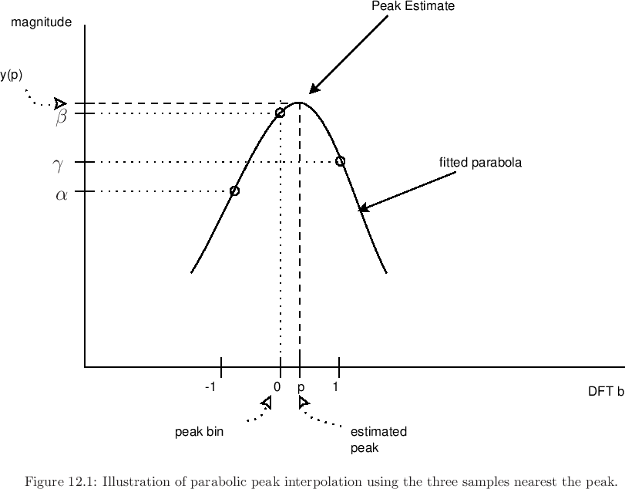
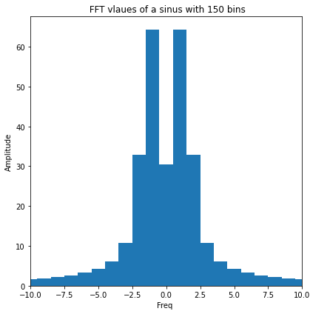

Peak Fitting
2 Methods to interpolate the exact frequency
To determine an offset:
Quadratic approach:
$y\left(x\right)={−a(x−p)}^{2}+b$ $p= \frac{1}{2}\frac{y\left(−1\right)−y(1)}{y\left(−1\right)−2∙y(o)+y(1)}$
Barycentric approach:
Weighted average $p= \frac{∆Y}{Y_{1}{+ Y}_{2}{+Y}_{3}}$ = $\frac{Y_{1} −Y_{3}}{Y_{1}{+ Y}_{2}{+Y}_{3}}$

Slide 6
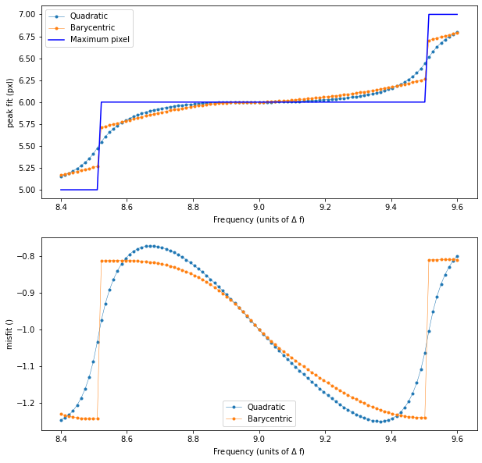
Result of First 2 Methods
Result for pure sine of 99 different frequencies between 8.4 and 9.6 delta f = 1/700, N = 70.
Quadratic approach:
Continous
Large misfits
Barycentric approach:
not continous.
Large misfits

Slide 7
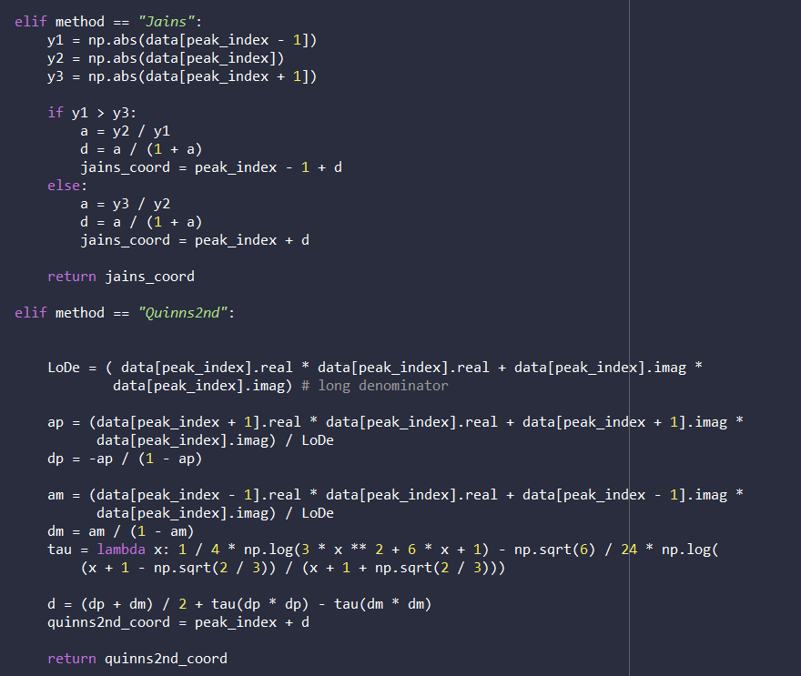
More Advanced Methods
3. Jain’s method
4. Quinn’s (2nd) method

Slide 8
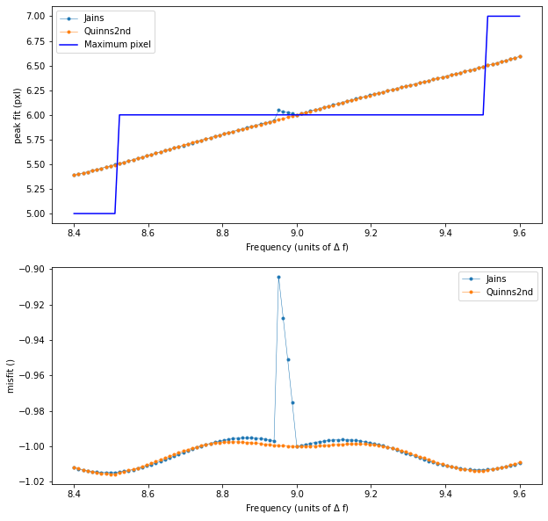
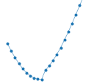
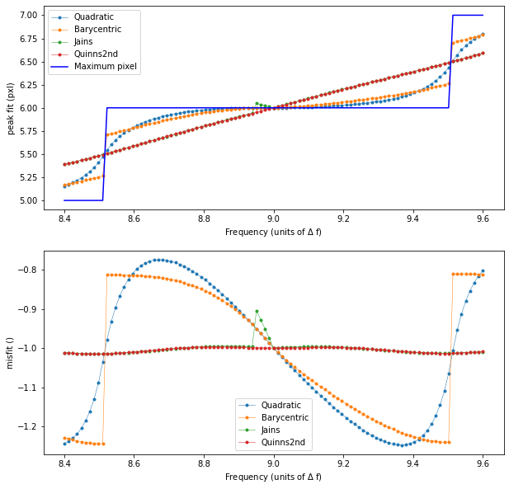
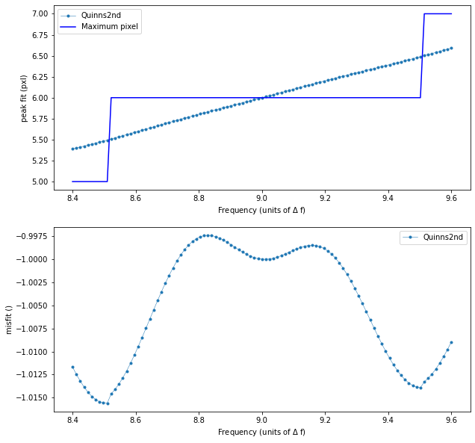
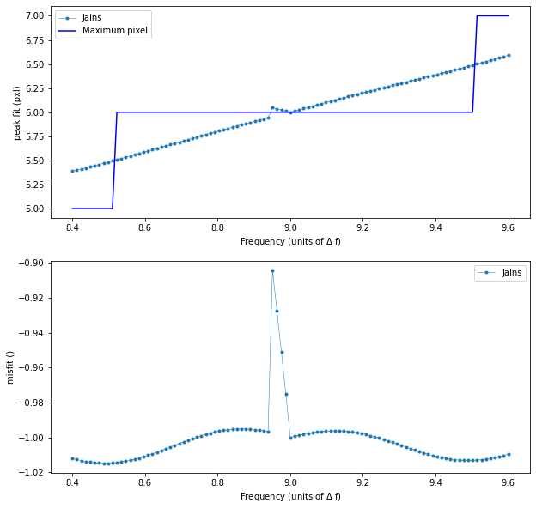
Result Jain’s and Quinn’s
Maximum deviation:
Generally Better
Neither is Continous

Slide 9
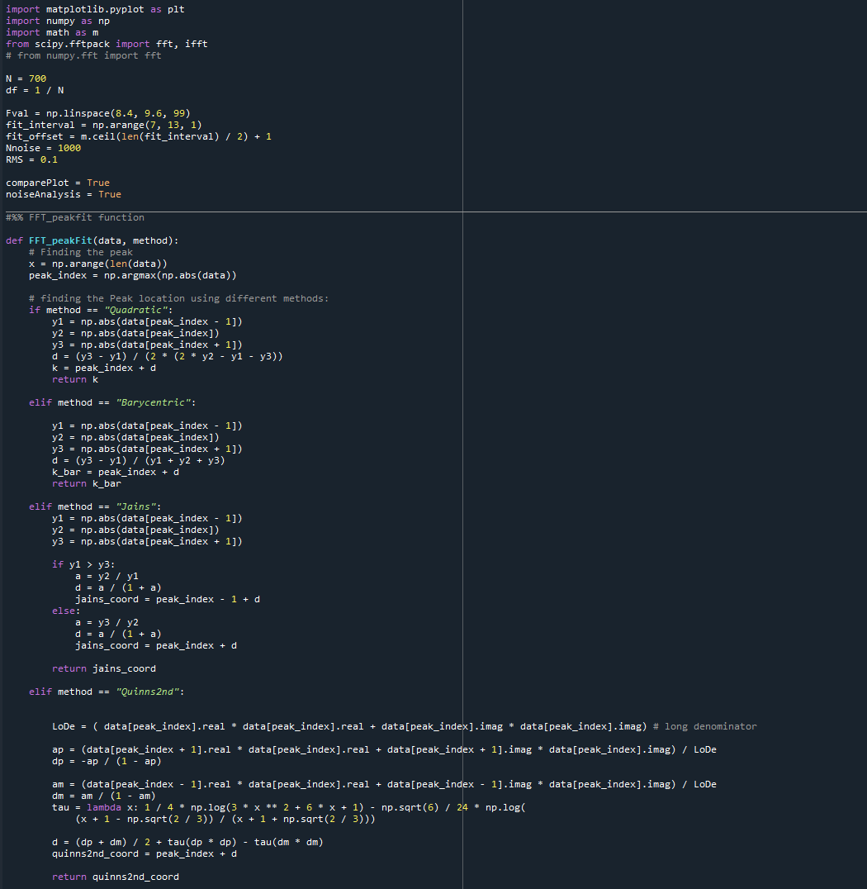
Our code
Currently:
Outlook:

